Slide 1
SolarWinds Hack
Ian Cook, BYU CSA Cybersecurity Symposium

Slide 2

What is Solarwinds?
Orion Networking Management Software
Used all over in almost every Industry

Slide 3
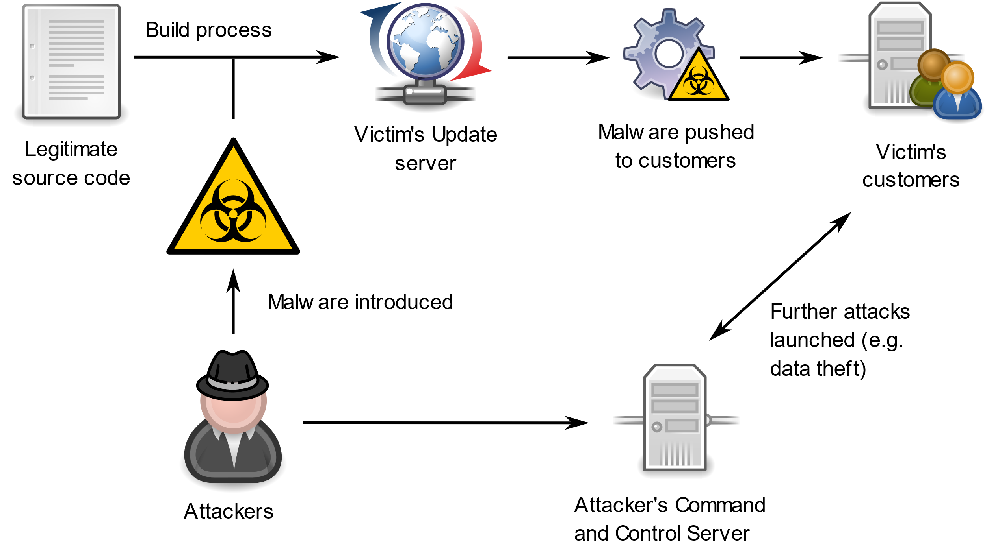
How did it happen? Supply Chain exploited in early February 2020

Slide 4
Discovery
FireEye, a Cybersecurity research and defense firm recognized and reported that they themselves were breached in mid December 2020.
SolarWinds estimates over 18,000 of its customers were impacted or exposed including many government entities.

Slide 5
Impact
Exploited software sat dormant for 2 weeks after reaching the users systems
Once a backdoor was live, data and actions have been able to be traced to some extent.
A kill switch was found in connection to a domain that
Unable to be 100% confident in damage due to how long it went undetected

Slide 6
Sources
https://www.nextgov.com/cybersecurity/2021/01/hack-roundup-solarwinds-shares-details-how-attackers-inserted-backdoor/171359/
https://www.cnn.com/2020/12/16/tech/solarwinds-orion-hack-explained/index.html
https://www.washingtonpost.com/business/the-facts-and-mysteries-about-russias-hack-of-the-us/2021/01/05/b8677266-4fa7-11eb-a1f5-fdaf28cfca90_story.html
https://krebsonsecurity.com/2020/12/malicious-domain-in-solarwinds-hack-turned-into-killswitch/
https://apnews.com/article/technology-hacking-coronavirus-pandemic-russia-350ae2fb2e513772a4dc4b7360b8175c?utm_source=Twitter&utm_campaign=SocialFlow&utm_medium=AP
https://apnews.com/article/hacking-solarwinds-cybersecurity-texas-1467388fe7234f2d3619289a49060eab
https://apnews.com/article/us-agencies-hacked-global-cyberspying-e8a2e819f7cc6982f6a72f8c85209b72
https://apnews.com/article/politics-national-security-hacking-russia-software-ecdb72e2004e32743f28fccd5f55b1b1

